Slide 1
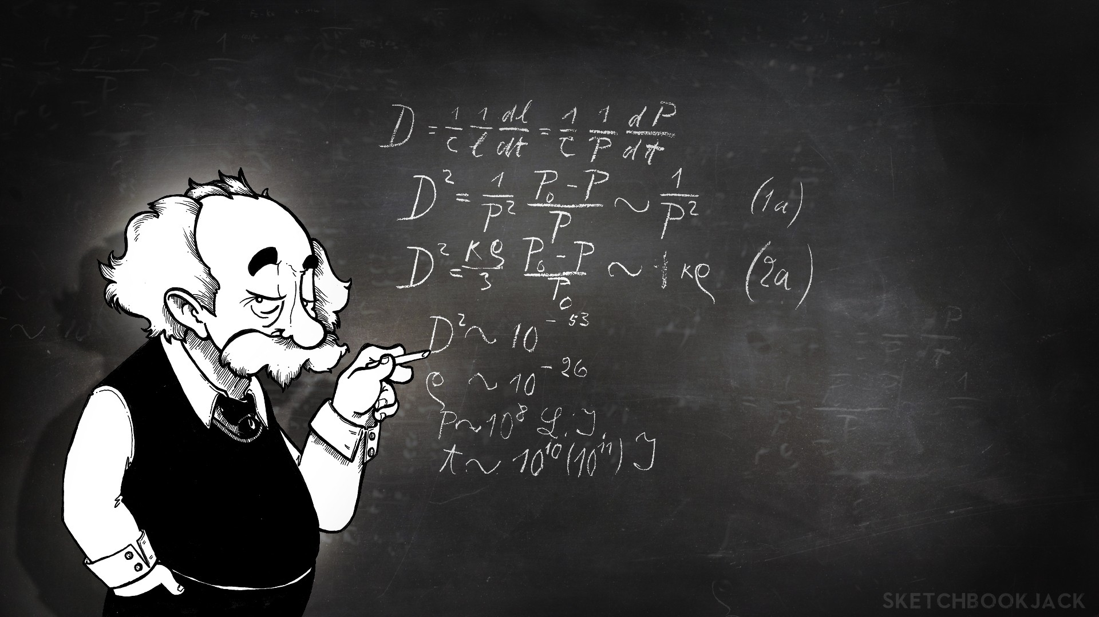
GOOD morning
EVERYONE

Slide 2
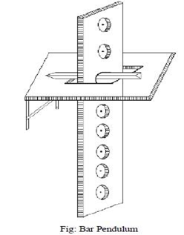
EXPERIMENT 03
To determine the value of g, acceleration due to gravity by means of a compound pendulum.

Slide 3

PRESENTER
MD. abu towsif
Farjana yESMIN opi
A.f.m. rafiul hassan
Md. Ashikuzzaman abir
Eshika rani pall

Slide 4
OUTLINE
Objective
Introduction
Mathematical formulation of working formula
Steps of experimentation
Collected data
Analysis of data & results
Quality of data and errors
Conclusion
Acknowledgements

Slide 5
OBJECTIVE
There are many way of measuring this gravity acceleration, but the experiment of compound pendulum is the easiest and effective among them. In the experiment the acceleration due to gravity was measured using the rigid pendulum method.
A rigid body with distributed mass able to freely pivot about a horizontal axis which does not coincide with the centre of gravity is called acompound pendulum.
INTRODUCTION

Slide 6
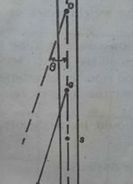
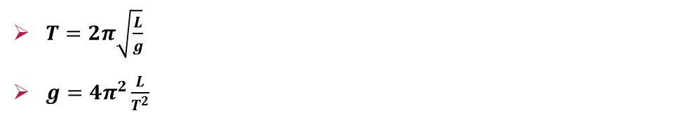

MATHMETICAL FORMULA
$T=2π\sqrt{\frac{L}{g}}$
$g=4π^{2}\frac{L}{T^{2}}$
$$τ=mgl Sinθ$$
For small amplitude of vibrations, $sinθ=θ$, so that
$$τ=mglθ………………(1)$$
$$τ=Iα………………..(2)$$
So, from equation (1) and (2),
$Iα=mglθ……………(3)$
$$I={(K}^{2}+l^{2})$$
Substituting the value of I in equation (3), we get
$$m\left(K^{2}+l^{2}\right)α=mglθ,α=\frac{glθ}{(K^{2}+l^{2})}$$
$$T=2π\sqrt{\frac{K^{2}+l^{2}}{gl}}……………………….(4)$$
Since the periodic time of a simple pendulum is given by,$T=2π\sqrt{\frac{L}{g}}$

Slide 7
Steps of experimentation
i) Suspend the bar using the knife edge of the hook through a hole nearest to one end of the bar.
ii) Allow the bar to oscillate in a vertical plane with small amplitude (within 40 of arc).
iii) Note the time for 20 oscillations by a precision stopwatch by observing the transits of the vertical line on the bar through the telescope. Make this observation three times and find the mean time t for 20 oscillations. Determine the time period T.
iv) Measure the distance d of the axis of the suspension, i.e. the hole from one of the edges of the bar by a meter scale.
v) Repeat operation (i) to (iv) for the other holes till C.G of the bar is approached where the time period becomes very large.
vi) Invert the bar and repeat operations (i) to (v) for each hole starting from the extreme top.
vii) Draw a graph with the distance d of the holes as abscissa and the time period T as ordinate.

Slide 8
Collected data table 01
Observation for the time period and the distance of the point of suspension from CG for End- A
Hole no. | Distance From CG,L(cm) | Time for 20 Oscillations(s) | Mean time t(s) | Period T = t / 10(s)
1 | 45 | (1)15.75 | 15.67 | 1.57
 |  | (2)15.59
2 | 40 | (1)15.45 | 15.495 | 1.55
 |  | (2)15.54
3 | 35 | (1)15.47 | 15.235 | 1.52
 |  | (2)15.00
4 | 30 | (1)15.32 | 15.13 | 1.53
 |  | (2)14.94
5 | 25 | (1)15.19 | 15.165 | 1.52
 |  | (2)15.14
6 | 20 | (1)15.36 | 15.355 | 1.54
 |  | (2)15.35
7 | 15 | (1)16.83 | 16.63 | 1.66
 |  | (2)16.43

Slide 9
table 02
Observation for the time period and the distance of the point of suspension from CG for End- B
Hole no. | Distance From CG,L(cm) | Time for 20 Oscillations(s) | Mean time t(s) | Period T = t / 10(s)
1 | 45 | (1)15.54 | 15.72 | 1.57
 |  | (2)15.80
2 | 40 | (1)15.44 | 15.535 | 1.55
 |  | (2)15.63
3 | 35 | (1)15.54 | 15.295 | 1.53
 |  | (2)15.05
4 | 30 | (1)14.85 | 14.93 | 1.49
 |  | (2)15.01
5 | 25 | (1)14.93 | 14.925 | 1.49
 |  | (2)14.92
6 | 20 | (1)14.86 | 15.31 | 1.53
 |  | (2)15.76
7 | 15 | (1)16.17 | 16.23 | 1.62
 |  | (2)16.29

Slide 10
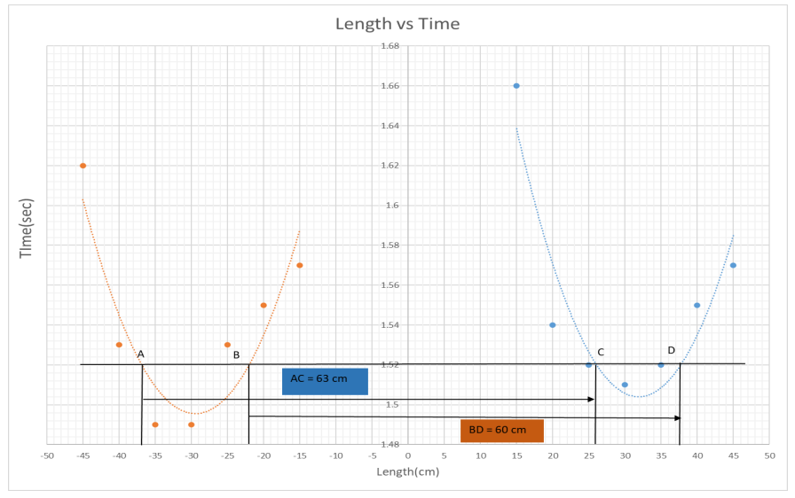
GRaph

Slide 11

analysis
From the T vs L graph,
Length AC = 63 cm, Length BD = 60 cm.
Equivalent length of compound pendulum, L = $\frac{AC+BD}{2}$ = 61.5 cm.
Equivalent time period of compound pendulum, T =1.52 sec.
Calculation
$$g= 4π^{2}\frac{L}{T^{2}}$$
$=\frac{4 ×\left(3.1416\right)2×61.5}{\left(1.52\right)2}$
$=$ 1050.87 cm/s² Where, g = acceleration
L = length of the pendulum
T = the period time of pendulum

Slide 12

analysis
Error Calculation
Percentage of error = | $\frac{1050.87−980}{980}$ | × 100%
= 7.23 %
RESULT
The value of g acceleration due to gravity measured by compound pendulum is found to be 1050.87 cm/sec² with an error of 7.23 %.

Slide 13
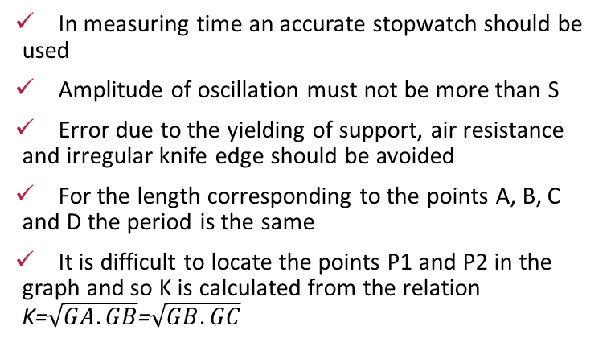
DISCUSSION & CONCLUSION
DISCUSSION
CONCLUSION
In measuring time an accurate stopwatch should be used
Amplitude of oscillation must not be more than S
Error due to the yielding of support, air resistance and irregular knife edge should be avoided
For the length corresponding to the points A, B, C and D the period is the same
It is difficult to locate the points P1 and P2 in the graph and so K is calculated from the relation K=$\sqrt{GA.GB}$=$\sqrt{GB.GC}$
Gravity acceleration is caused because of the massive body and mass of earth which can be used in many purposes, because acceleration is one of the major fact and element of force. So, we need to know the value of gravity acceleration. In this experiment we got the chance to measure the value of g, acceleration due to gravity was found 1050.87 cm/sec² with an error of 7.23%.

Slide 14

For your kind attention

